Slide 1


OSCE Parliamentary Assembly
Ulaanbaatar, 15-18 September 2015
Global Food and Nutrition Security: Where does Asia Stand?
Presented by Kevin Gallagher, Deputy FAO Representative, Mongolia

Slide 2
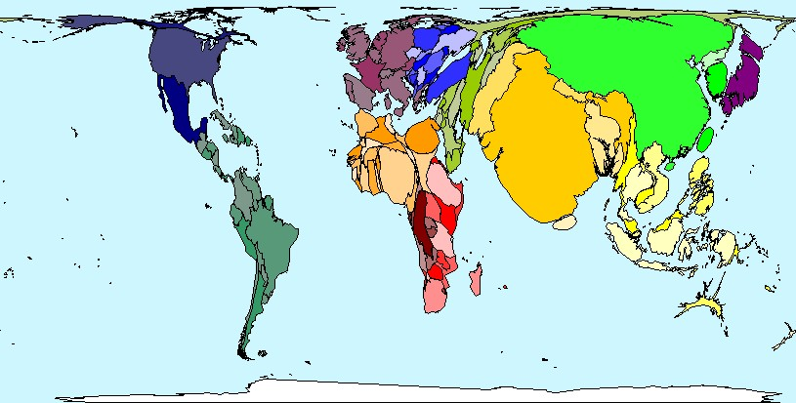
Current Status and Importance of World Food Security
Map of World Based on Population

Slide 3
Food Security Definition
Food security is achieved when all people at all times have access to sufficient, safe and nutritious food to maintain a healthy and active life.
-- World Food Summit 1996

Slide 4
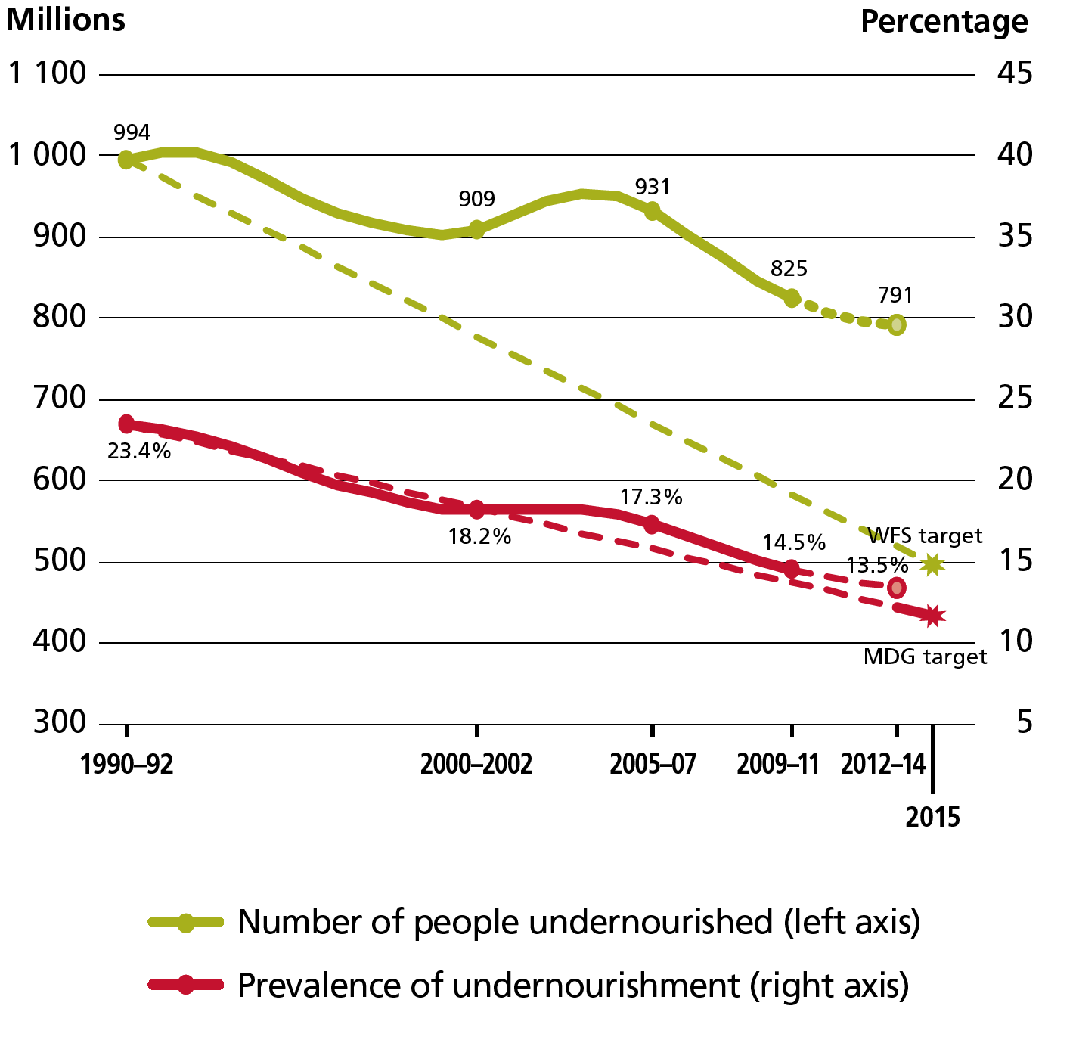
Undernourishment trends:
Developing Regions
Source: FAO/IFAD/WFP: State of Food Insecurity in the World 2014

Slide 5
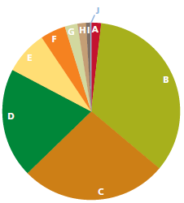
The changing distribution of hunger in the world:
Numbers and shares of undernourished people by region in 1990-92 and 2012-14
Total = 805 million (2012-14)
Notes:
At present, the world produces more than sufficient food to meet the demand of everyone, and maintains adequate food stocks.
Yet, the number of hungry people in the world remains unacceptably high. The world is a home of 805 million undernourished people in 2012-14. One in every 9 people worldwide are suffering from chronic hunger, and the vast majority of them (98%) live in developing countries.
Asia Region remains a home of nearly two-thirds (65%) of the world total chronic hunger population, despite its rapid economic growth.
The benefit of economic growth was not equally shared among populations in different economic status. In many cases, it benefitted the rich who could invest further, while the poor who did not have capitals or resources were left behind, which resulted in widening of income disparity and social equity.

Slide 6
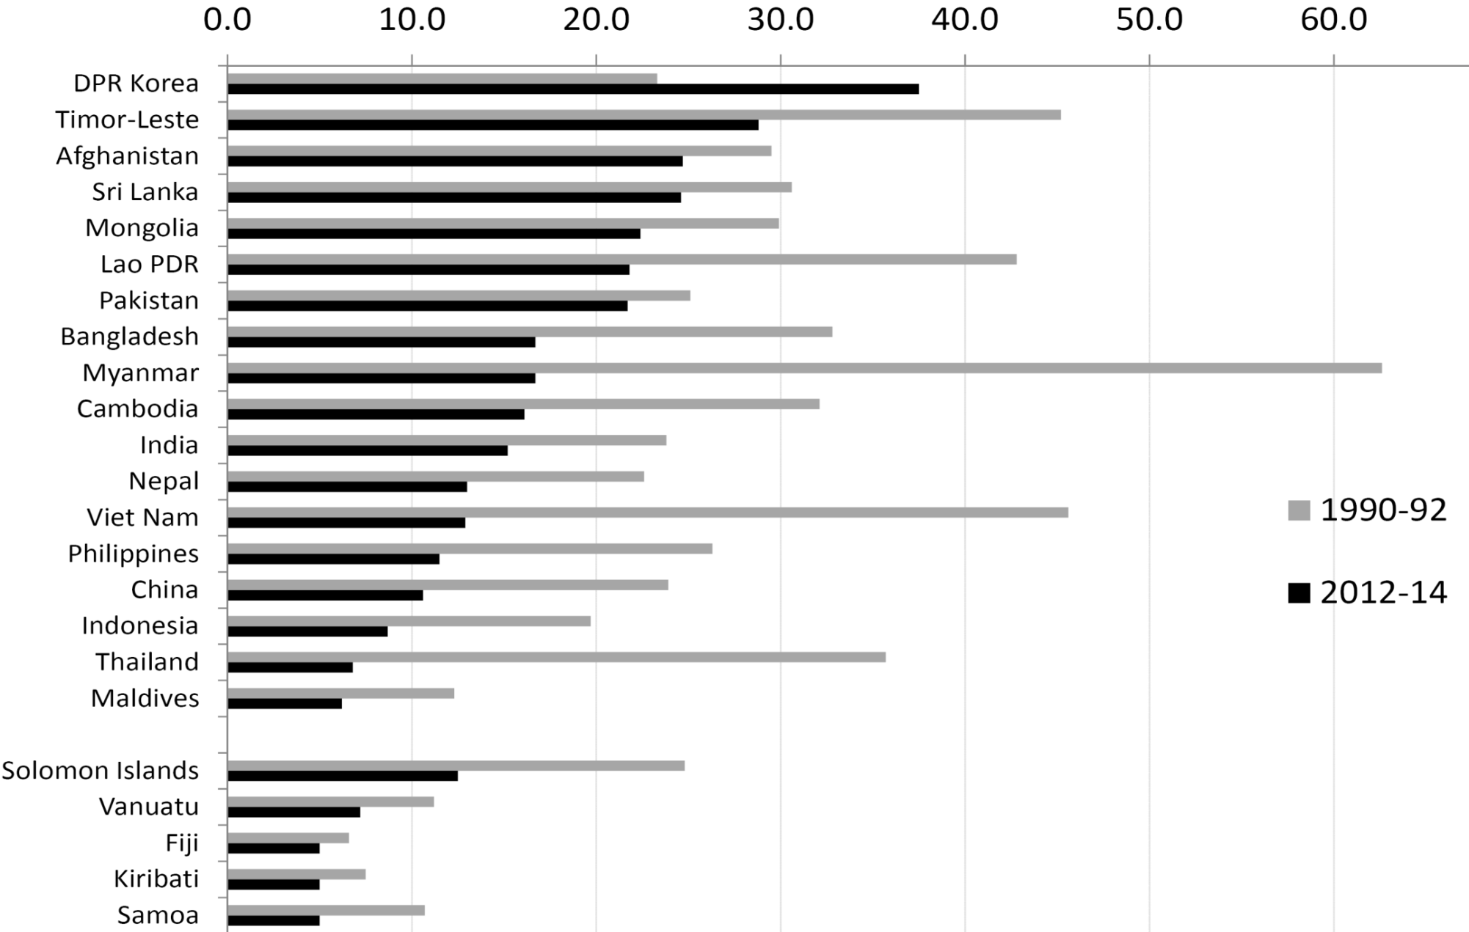
Proportion of undernourished in total population, selected Asian countries
Source: FAO/IFAD/WFP: State of Food Insecurity in the World 2014

Slide 7
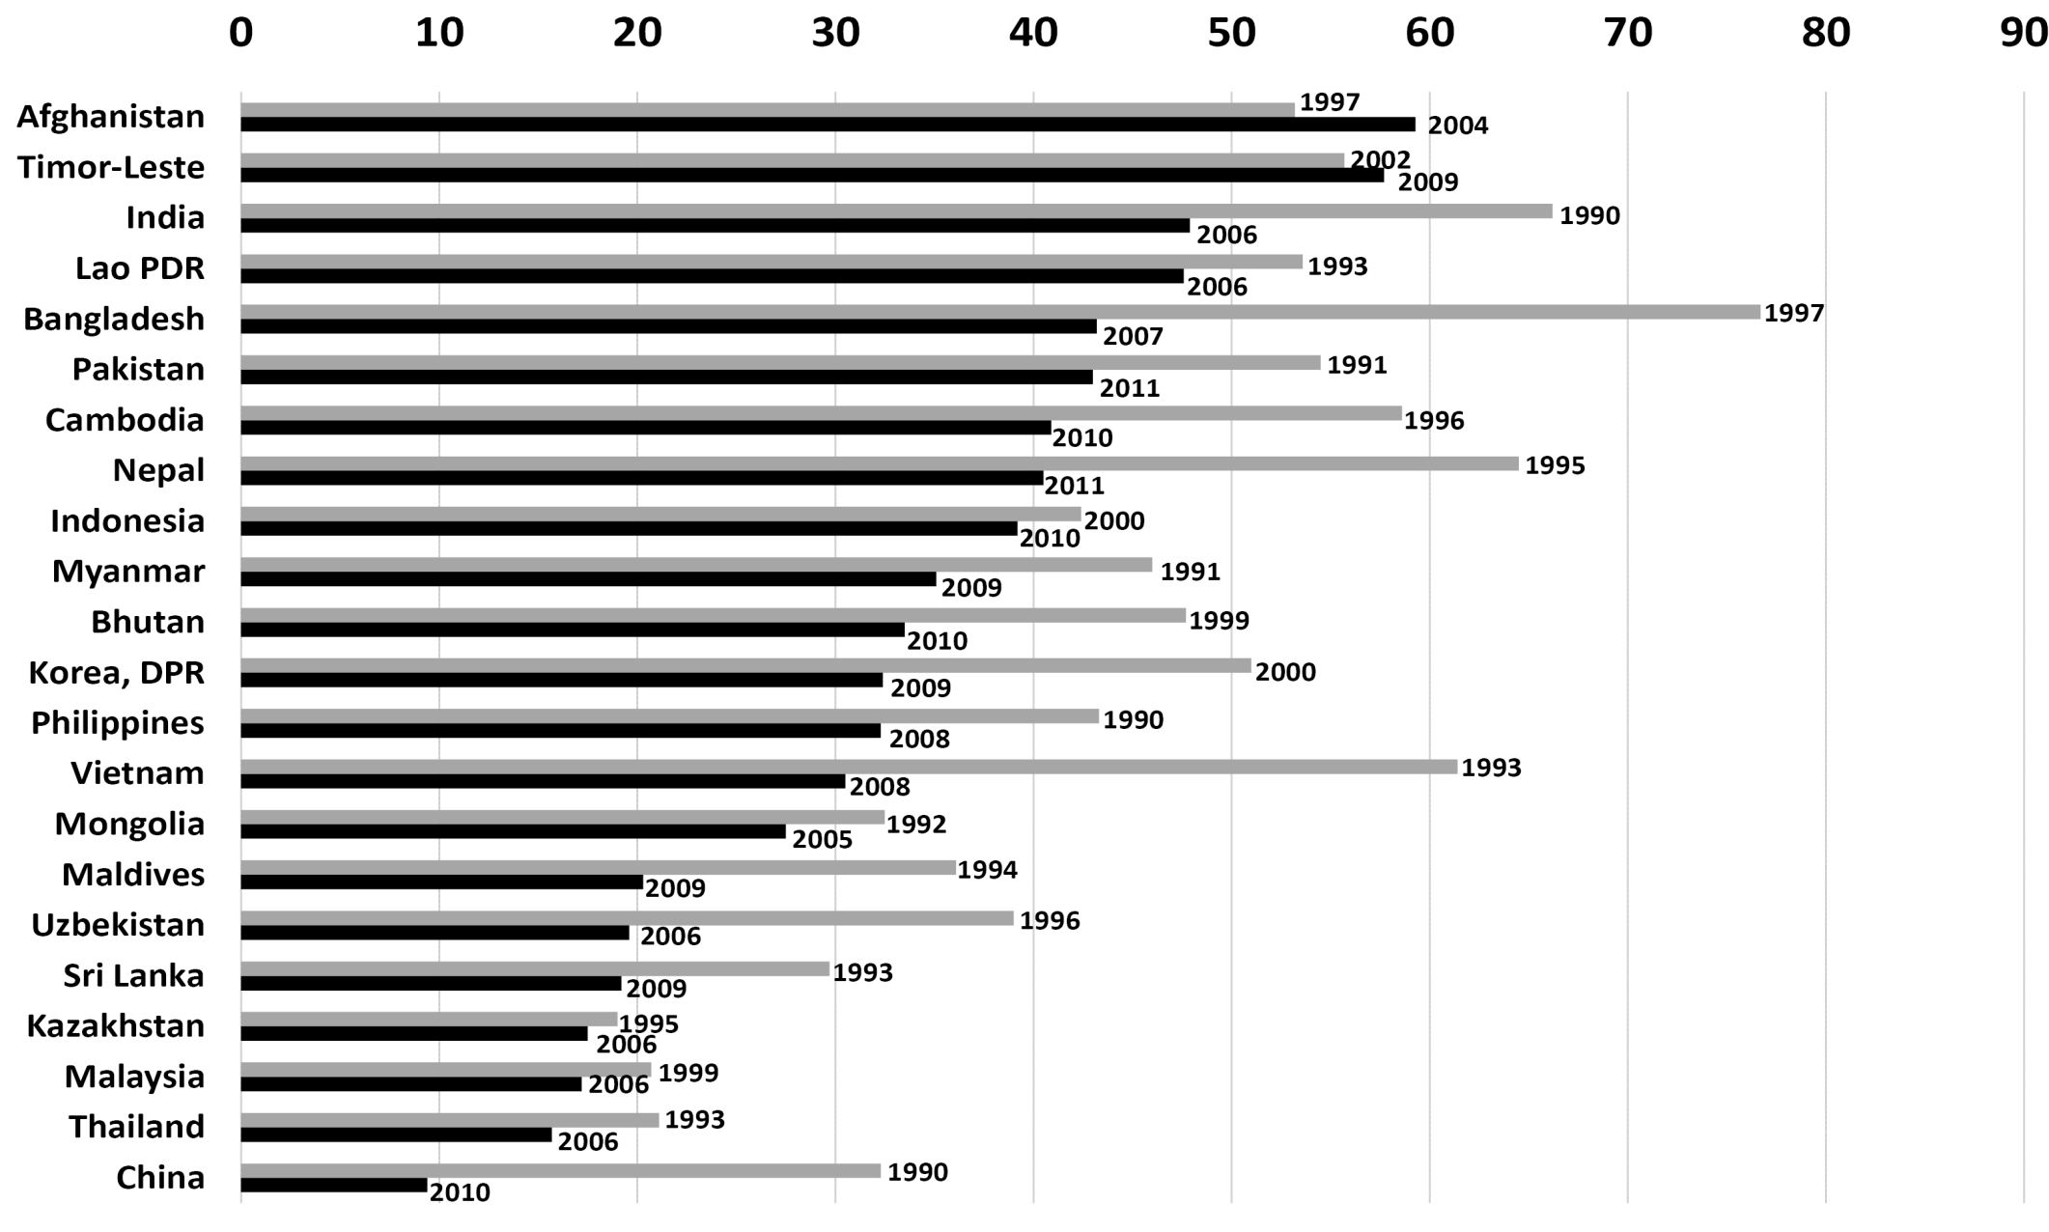
Prevalence of stunting in children under 5 in selected Asian countries
Source: World Bank, World Development Indicators, 2012

Slide 8
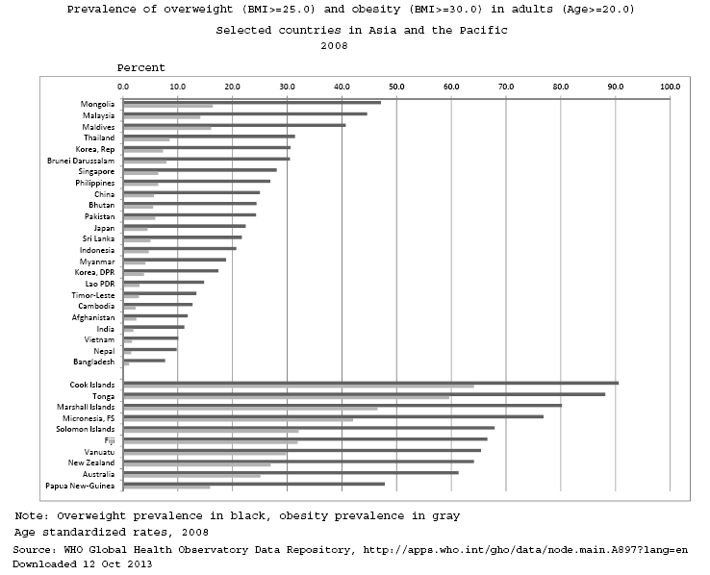
Obesity and overweight in Asia-Pacific

Slide 9
Future Food Demand
Future food demand is determined by:
  Population growth
  Increasing incomes (per capita GDP)
  Diversifying diets, especially from livestock feed
  Biofuels
  Climate change disasters
Global demand by 2050 must increase at least by 70% (FAO) but some estimates are up to 110% (Tilman et al.)

Slide 10
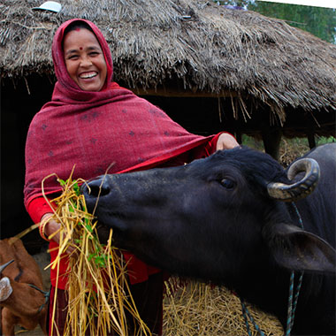
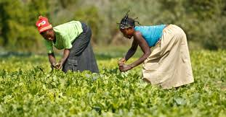
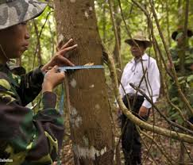
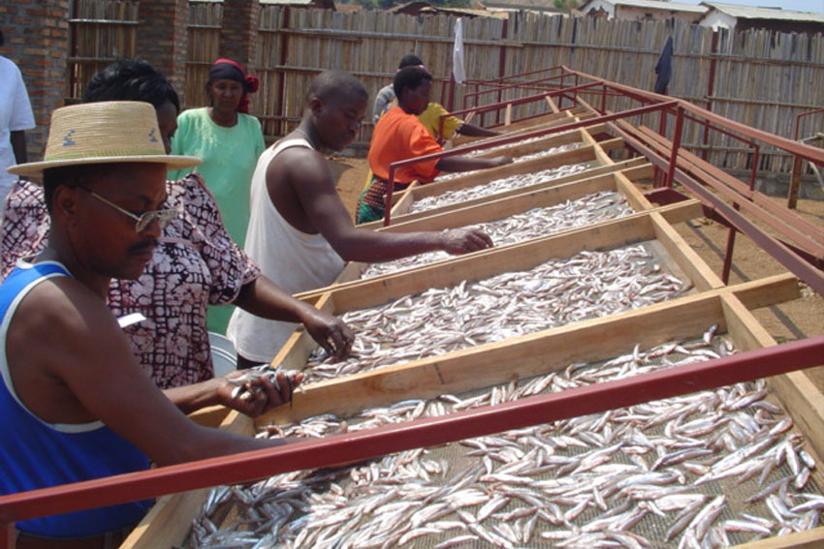
UN-FAO Activities to Achieve World Food Security
Foto: Heifer international

Slide 11
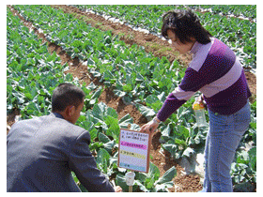
Global Sharing
Capacity Development
Policy makers
Technicians
Community organizations with governments

Slide 12
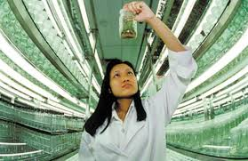
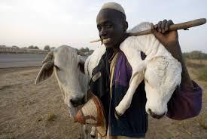
Emerging Concerns
Women in Agriculture
Youth and Aged in Agriculture
Urbanization
Climate change
Organic agriculture
And many others!

Slide 13
Conclusions
Food security underlies human security
Support to ensure production on one side and dignified jobs on the other side are critical to achieving food security
Social safety nets are critical tools to maintain inclusive development

