Slide 1
EASO presentation
Forum Méditerranéen de Skopje
Malin LARSSON-GRAVE
30 September 2016

Slide 2
Some facts about EASO
EASO is an EU agency set up by Regulation (EU) 439/2010 of the European Parliament and of the Council.
EASO in a nutshell:
acts as a centre of expertise on asylum;
contributes to the development of the Common European Asylum System by coordinating and strengthening practical cooperation among Member States on the many aspects of asylum;
helps Member States fulfil their European and international obligations to give protection to people in need;
provides practical and technical support to Member States and the European Commission;
provides operational support to Member States with specific needs and to Member States whose asylum and reception systems are under particular pressure;
provides evidence-based input for EU legislation in all areas having a direct or indirect impact on asylum.
130 staff by end 2016
63 MEUR budget in 2016

Slide 3
Asylum applications for international protection in EU+ countries: July 2013 - August 2016
+ 23 %
887k
720k

Slide 4
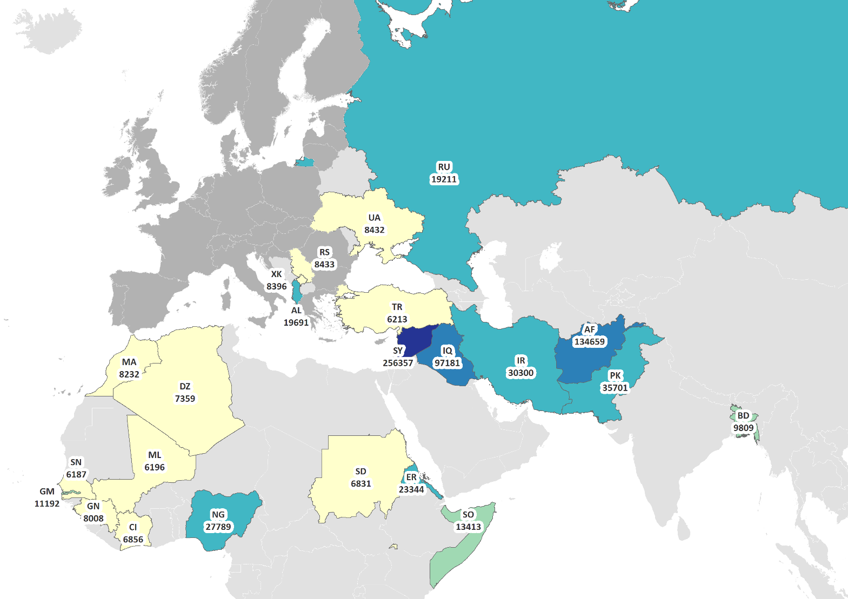
Main countries of origin of applicants in January-August 2016

Slide 5
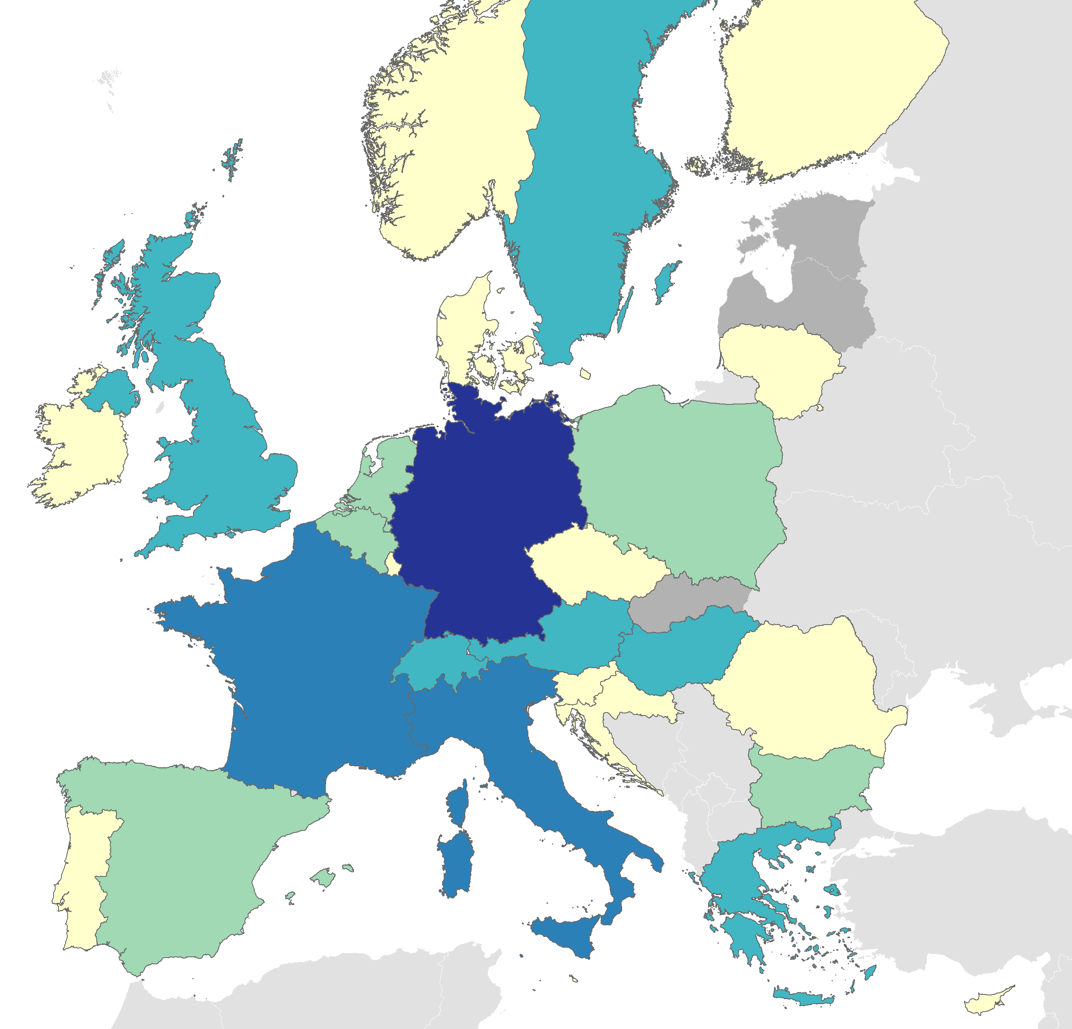
Main receiving countries of applicants in January-August 2016

Slide 6
First instance decisions and recognition rate, August 2014 – August 2016
+ 94%
667k
(58%)
344k
(45%)

Slide 7

EPS
Early Warning (asylum influx &
MS capacity)
Permanent Support
- Training and Quality
- Country of Origin
Information
- Practical cooperation
Operational Support
- Asylum Support Team
Capacity building
Tailor made
- Greece, Italy, Bulgaria, Cyprus
Hotspots - Relocation Procedure
- Provision of Info
- Registration
- Processing of outgoing Dublin cases
Hotspots - EU-TR Statement (EL)
- Admissibility procedure
- Eligibility procedure
External Dimension/Third Countries Support

Slide 8
EASO operational activities
EASO has scaled up its presence on the ground to live up to its commitment in under the EU Migration Agenda
EASO developed general support tools for relocation and intensified its logistics and operational support
Flexible and tailor-made approach to cope with changing realities on the ground
EASO is a key player in the implementation of the EU Relocation programme and the EU-Turkey Statement

Slide 9
EASO operations Greece
Relocation:
EASO supports the Greek authorities with the implementation on the Relocation scheme in Athens, Thessaloniki and Alexandroupoli.
EU-TR Statement:
EASO supports the Greek authorities with the implementation on the EU-TR Statement in the admissibility procedure and the full examination of applications for international protection (eligibility) in the five hotspots Lesvos, Chios, Samos, Leros and Kos and in the pre removal centre of Corinth.
EASO Special/Operational Support
EASO support to Greece dates back to April 2011, when the Operating Plan Phase I was signed. Under the Operating Plan Phase I, EASO supported Greece with 1) tackling the backlog, 2) setting up of a sustainable and efficient asylum and reception structure and 3) guaranteeing the quality of the asylum process.
The EASO Special Support Plan to Greece was signed on 13 May 2015, the duration is extended until 31 Dec 2016
EASO’s specific technical and operational support to Greece includes: support in COI activities, practical support to reception centres, support in training Greek personnel, support with the absorption of EU funds and other financial resources

Slide 10
EASO operations Italy
Relocation:
EASO supports the Italian authorities with the implementation on the Relocation scheme in the hotspots Lampedusa, Pozzallo, Taranto and Trapani and in Rome (including a mobile team), Siculiana (Villa Sikania), Catania (mobile team), Crotone, Bari and Mineo.
EASO Special Support
EASO Special Support Plan for the provision of technical and operational assistance was signed in June 2013 (Phase 1)
EASO Special Support Plan (Phase 2) was signed in March 2015
In line with the Special Support Plans, EASO has been providing special support and tailor-made assistance in the following main areas: Joint processing activities and capacity building in the national asylum procedure.
EASO activities include: Special quality control tools, registration of applications for international protection, COI activities and support to Territorial Commissions in preparing case files.

Slide 11
Registration: in particular in Greece
More pledges needed: Last call for 100 experts under the EU-TR resulted in only 31 nominations
Risk of absconding - also due to long waiting times; a quick procedure and more success stories are needed
Number of persons eligible for relocation above processing capacity (high arrivals) - many people waiting in the system
Availability of MS experts offered by the MS – more experts needed and for longer period
Changing reality on the ground
Current main challenges

Slide 12
How is EASO tackling these challenges?
Highly flexible/Response adaptable to local conditions
Focus on procedures and quality in a very challenging context
Targeted scaling up of operations after appropriate testing
Focus more on relocation streams outside of hotspots
Deployment of mobile teams and offices
Implement communication strategy

Slide 13

Common European Asylum System –
External Dimension

Slide 14
An example of EASO EXTDIM Support the ENPI Project
ك
الأردن في أعمال EASO
ومشاركة
تونس والمغرب
في أعمال EASO وFRONTEX
Title of the project: Participation of Jordan in the work of EASO and participation of Tunisia and Morocco
in the work of EASO and FRONTEX
Financed through the European Neighbourhood and Partnership Instrument
Signature of the contract: 31 December 2013
Start of the project: 1 March 2014
Duration of the project: 28 months (Project ended on 30 June 2016)
Partner countries: Jordan, Morocco, Tunisia
EU-Mobility Partnerships: Morocco, 7 June 2013 Tunisia, 13 November 2013 Jordan, 9 October 2014
Involving EASO, FRONTEX, MS, EU Delegations, DG HOME, DG NEAR, DG DEVCO and in coordination with UNHCR, IOM, other IOs and NGOs

Slide 15
IPA II Programme
Title of the project: Regional support to protection-sensitive migration management in the Western Balkans and Turkey
Geographical coverage: Albania, Bosnia and Herzegovina, Serbia, Former Yugoslav Republic of Macedonia, Montenegro, Kosovo* and Turkey
Duration of the project and planned start date: Three years: 1 January 2016- 31 December 2018
Total budget: 8,25 MEUR
Implementing organisation and participating organisations/ Member States: Frontex and IOM are the beneficiary of the contracts (two contracts); EASO implements activities with EU Member States (MS) and Associated Countries (AC), in cooperation with Frontex, UNHCR and IOM
Target group: National authorities with operational responsibilities on matters related to asylum and/or international protection of refugees and asylum seekers.

Slide 16
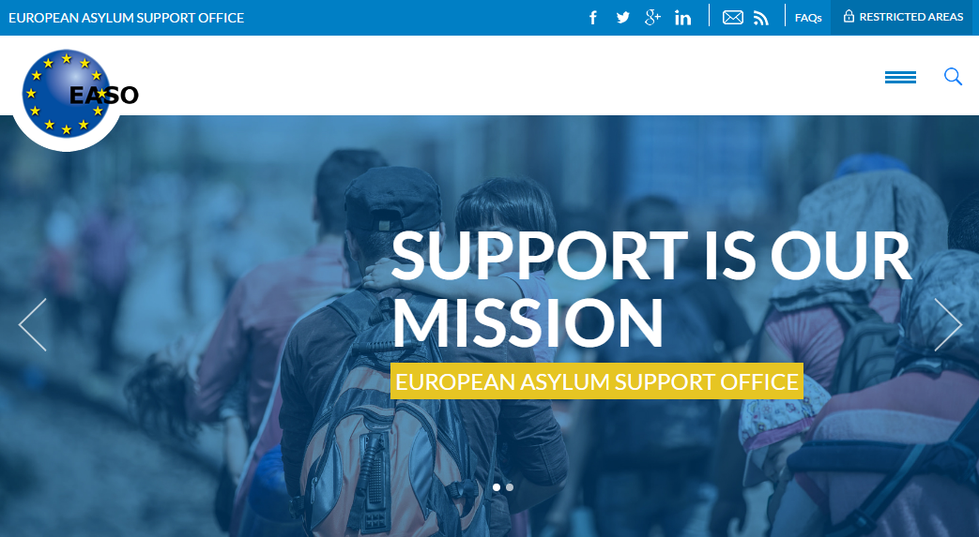
www.easo.europa.eu Thank you!

