Slide 1

Importance of international cooperation to ensure energy security – case of the gas in the Energy Community
OSCE PA

Slide 2
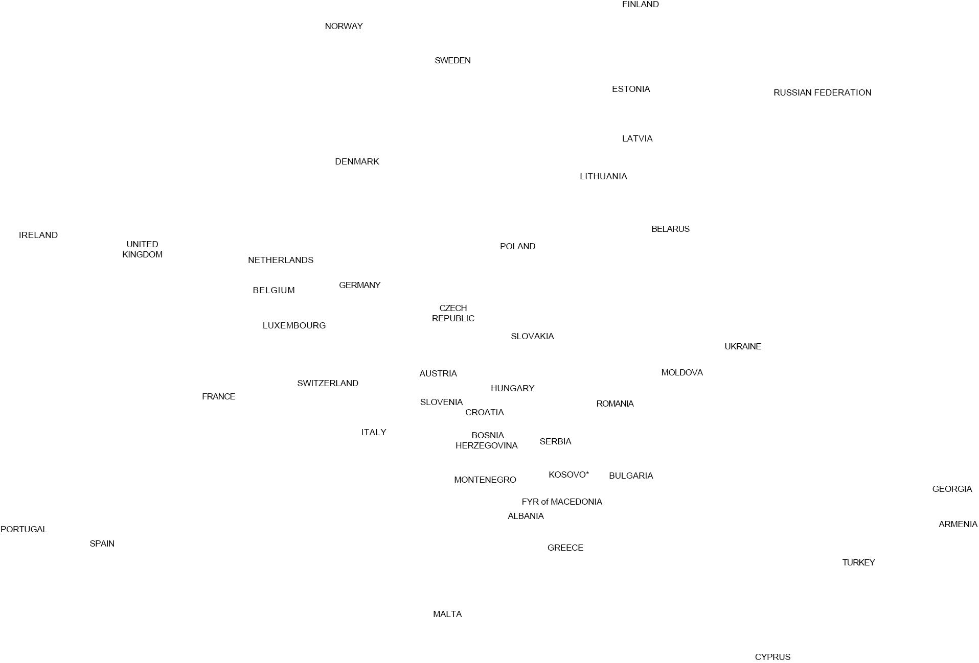
Energy
Community Map
European Union
Contracting Parties
Candidate
Observers

Slide 3
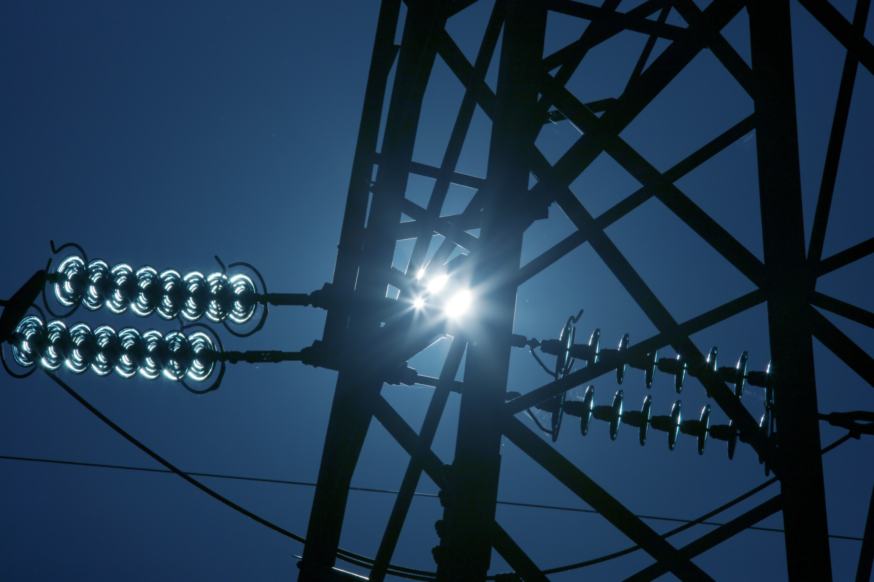
Key aims
  1. Attract investment in power generation and networks in order to ensure stable and continuous energy supply that is essential for economic development and social stability
  2. Create an integrated energy market allowing for cross-border energy trade and integration with the EU market
  3. Enhance the security of supply
  4. Improve the environmental situation in relation with energy supply in the region
  5. Enhance competition at regional level and exploit economies of scale

Slide 4
The common legal framework – EnC acquis
  Gas (Second, Third package) (2 Directives, 2 Regulations) + REGULATION 994 /2010 on Security of Gas Supply
  Electricity (Second, Third package) (2 Directives, 3 Regulations)
  Environment (5 Directives: Large Combustion Plants Directive, Industrial Emissions Directive, Environmental Impact Assessment Directive, Sulphur in Fuels Directive, Wild Birds Directive)
  Competition (some provisions of the Treaty)
  Renewable energy sources (RES Directive)
  Energy efficiency (3 Directives: Energy Services Directive, Energy Performance of Buildings Directive, Energy Labelling Directive, 9 Technical Regulations)
  Antitrust and state aid (some provisions of the Treaty)
  Statistics (1 Directive, 1 Regulation)
  Oil Stocks (1 Directive)

Slide 5
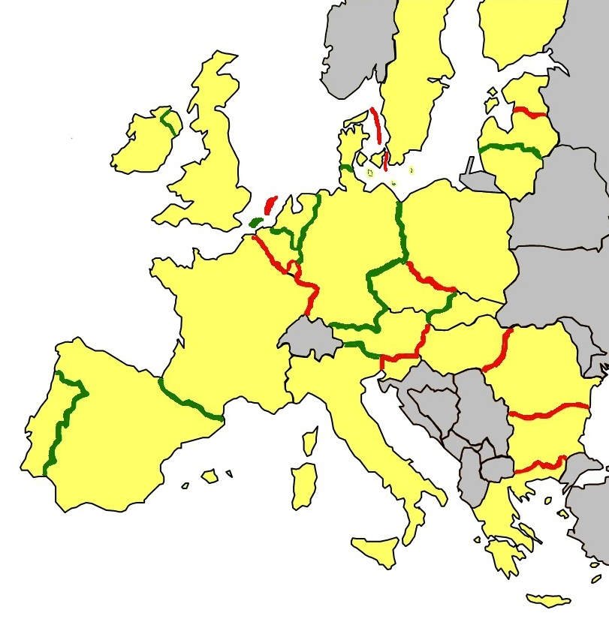

Enforcement: Bridging the gap between Member States
GAS FLOWS
No Flows
Flows only in one direction
Flows in two directions
Energy

Slide 6
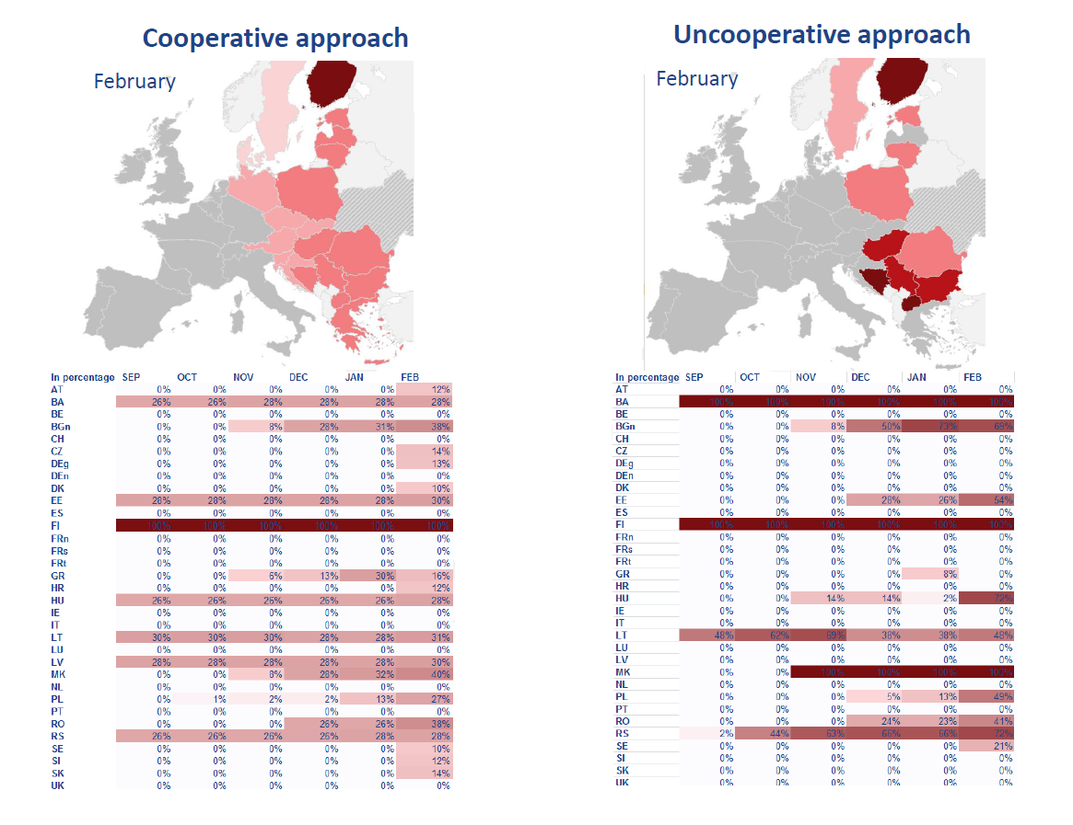
Russian 6-month disruption (1)
Source: ENTSOG

Slide 7
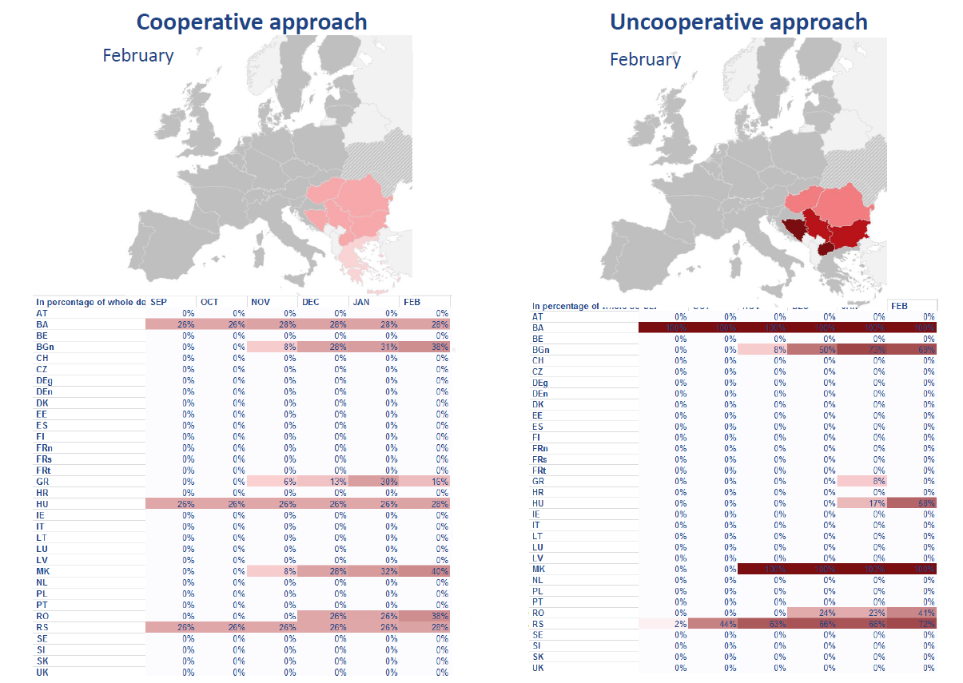
Ukraine 6-month disruption
Source: ENTSOG

Slide 8
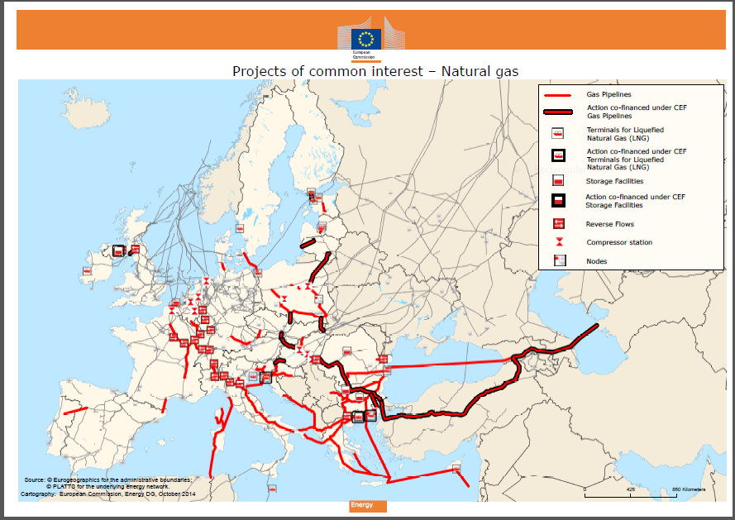

Slide 9
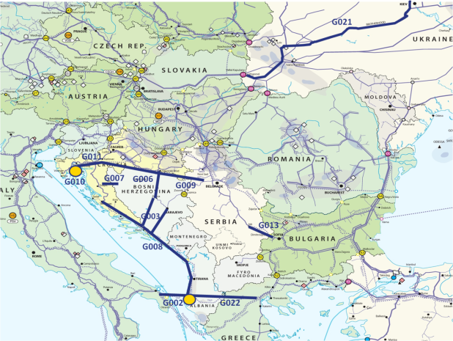
PECI Gas Infrastructure
LNG Terminal
Gas pipeline

Slide 10
Compliance with the N-1 infrastructure standard
Compliance with the N-1 infrastructure standard (Art. 9 of Regulation No 994/2010) - before and after the implementation of the PCIs
no
yes
Source: Commission
Notes:
10

Slide 11
The internal energy market can deliver
Economic
growth
Jobs
Secure
supply
Sustainable
use of limited
resources
Affordable
energy

Slide 12
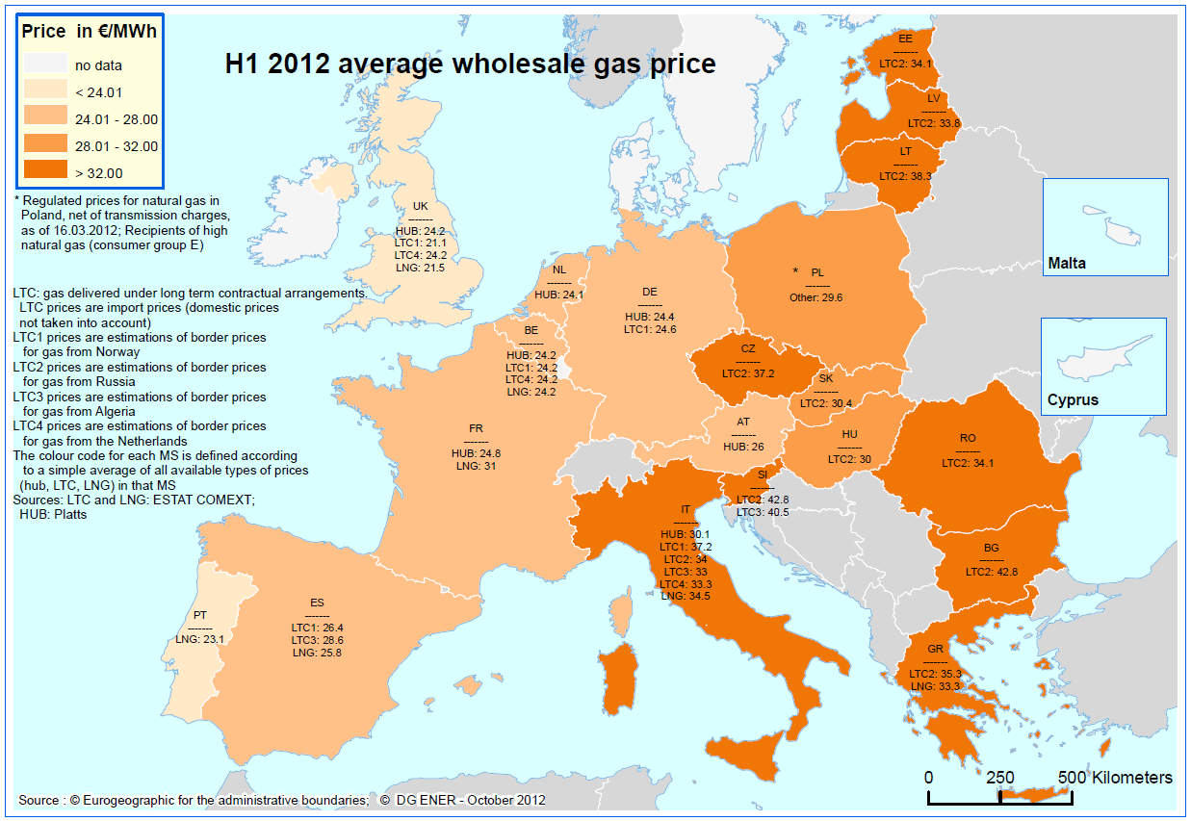
Lower prices in competitive and open markets

Slide 13
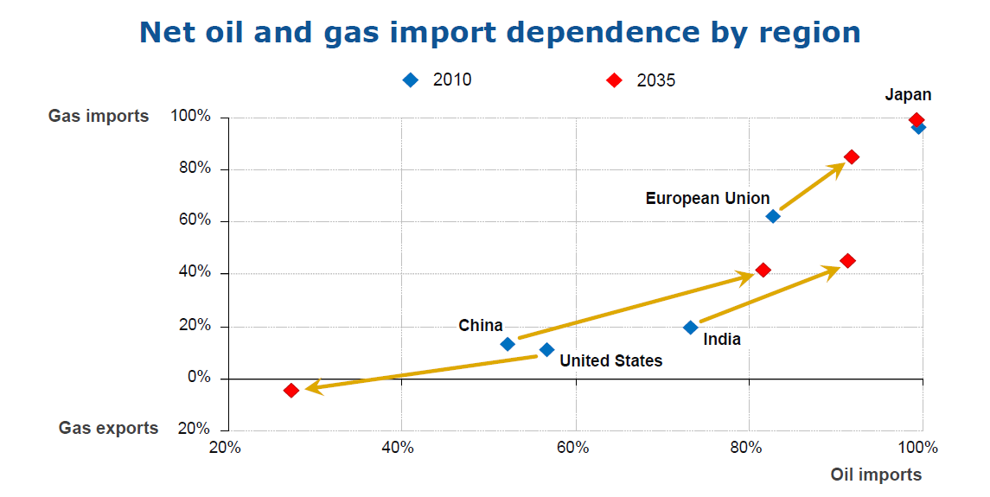
Dependence is set to increase

Slide 14
Thank you for your attention!
www.energy-community.org

