Slide 1


osce.org
Jan Plešinger
Head of the Prague Office of the OSCE Secretariat
WHAT KIND OF FUTURE FOR OSCE FIELD PRESENCES?

Slide 2
OSCE Missions and Field Operations
OSCE missions are an important instrument of multilateral diplomacy in the areas of conflict prevention and crisis management.
About 2,500 OSCE associates are currently working in 18 missions (called "missions", "offices" or "project offices") in 16 countries of South Eastern Europe, Eastern Europe, the Caucasus and Central Asia.
Mandates are agreed on in the OSCE Permanent Council by consensus, i.e. including the vote of the host country. The mandates of individual missions can take various forms, depending on the situation and needs of the host country. They comprise, inter alia, support and advisory services in the promotion of democracy and the rule of law, human rights and the rights of minorities as well as civil society development.

Slide 3
Prague Office of the Secretariat and the OSCE field presences
Prague Office is the OSCE documentation centre
Materials from the closed mission are at your disposal both physically and electronically
Researcher-in-Residence programe enables access to historical files
There are many lessons to be learned from the closed field presences
Studying the past may help us to avoid future mistakes
Prague Office dissemimates public information

Slide 4
Learning the Lessons of the Past
Explanatory notes: OSCE presence with some other form of continuity, OSCE highly specific missions with terminated task,
terminated OSCE presence in EU countries, OSCE presence terminated abruptly or sooner than expected
OSCE Missions of Long Duration in Kosovo, Sandjak and Vojvodina
OSCE Mission to Ukraine
OSCE Kosovo Verification Mission
OSCE Representative to the Joint Committee on the Skrunda Radar Station
OSCE Mission to Estonia
OSCE Mission to Latvia
OSCE Advisory and Monitoring Group in Belarus
OSCE Assistance Group to Chechnya
OSCE Centre in Tashkent
OSCE Representative to the Estonian Expert Commission on Military Pensioners
OSCE Mission to Croatia
OSCE Centre in Dushanbe
OSCE Mission to Georgia
OSCE Office in Minsk
OSCE Office in Zagreb

Slide 5
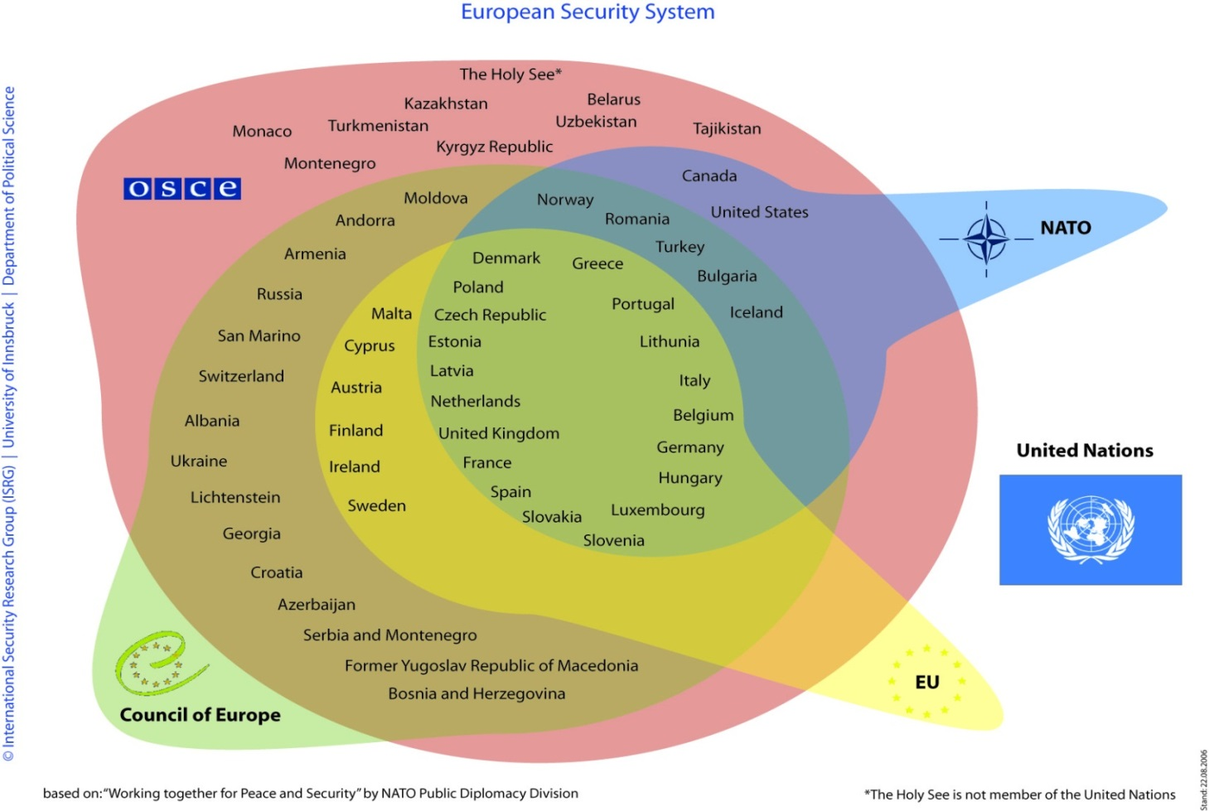
Cooperation with other institutions -
Does the OSCE presence in the field correspond to lack of international cooperation from a host country?

Slide 6
Is OSCE field presence a stigma for the host country?
Different qualities and level of control by respective host countries, different mandates and methods of work – diplomacy, projects, cooperation etc.
Presence in Albania
Mission to Bosnia and Herzegovina
Mission in Kosovo
Mission to Montenegro
Mission to Serbia
Mission to Skopje
Mission to Moldova
Project Co-ordinator in Ukraine
Special Monitoring Mission to Ukraine
Observer Mission at the Russian Checkpoints Gukovo and Donetsk
Project Co-ordinator in Baku
Office in Yerevan
Centre in Ashgabat
Programme Office in Astana
Centre in Bishkek
Office in Tajikistan
Project Co-ordinator in Uzbekistan

Slide 7
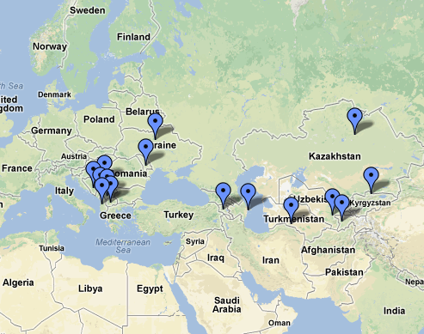
Geographical distribution of OSCE Missions and Field Activities
South Eastern Europe
Albania
Bosnia-Herzegovina
Kosovo
Montenegro
Serbia
Skopje (Macedonia)
Eastern Europe
- Moldova
Ukraine
South Caucasus
Baku (Azerbaijan)
Yerevan (Armenia)
Central Asia
Ashgabat (Turkmenistan)
Astana (Kazakhstan)
Bishkek (Kyrgyzstan)
Tajikistan
Uzbekistan

